Slide 1
Mushroom Classification
Distinguishing poisonous From Edible Mushrooms

Slide 2
CONTENTS
01
Introduction
Why this project is and how machine learning can helps in achieving our goal.
Executive summary
02
Summary of the Project that is all explanation in one page.
ML model detail
03
This section we will know about ml model and its result.
04
EDA on important features
Here we analyze the data
05
Recomendation
Recommendation about project

Slide 3
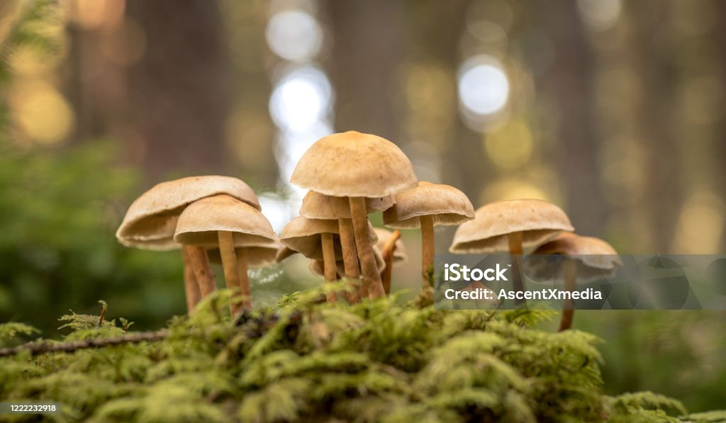
Introduction
Mushroom is one of the fungi type food that has most potent nutrients on the plant. Mushroom have major medical advantages such as killing cancer cells. There are over 45000+ species of mushrooms and only small fraction of them are edible.
Mushroom classification is the process of identifying mushrooms and classifying them into different categories based on edibility.
The study aims to find most appropriate technique for mushroom classification and mushroom will be classified into two categories , poisonous and edible.

Slide 4
Executive Summary
RandomForestClassifier is the optimum model for classification of mushrooms either edible or poisonous.
There are some models like DecisionTree Classifier, SVC are giving 100% accuracy, may leads to overfitting, so we choose RandomForest Classifier.
From RandomForestClassifier model, we conclude some features are more helpful than others in prediction of edibility of mushrooms.
There are some features having maximum missing values, so, we dropped them and some features with less missing values, there, imputed respective mode values of that feature as they are categorical.

Slide 5
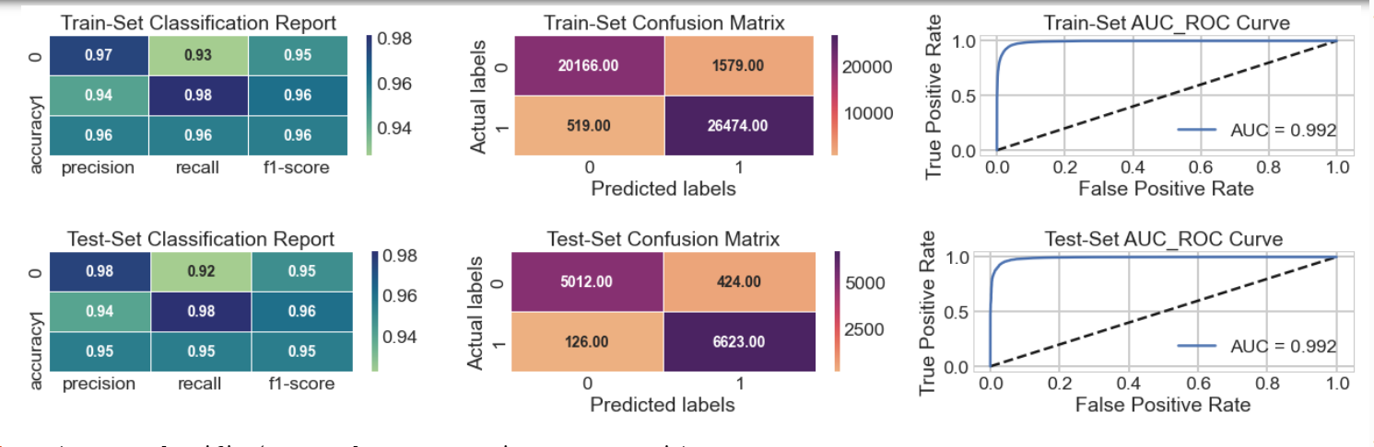
RandomForest Classifier model evaluation metrics

Slide 6
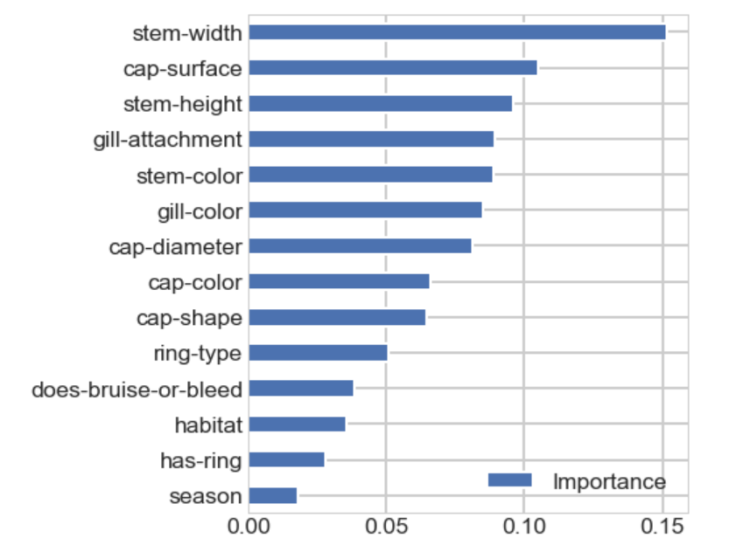
Feature Importance
Stem-width, cap-surface, stem-height, gill-attachment, gill-color are the most important features for determining edibility of mushroom.
Similirly, does-bruise-or-bleed, habitat, has-ring and season are least important in determining edibility.

Slide 7
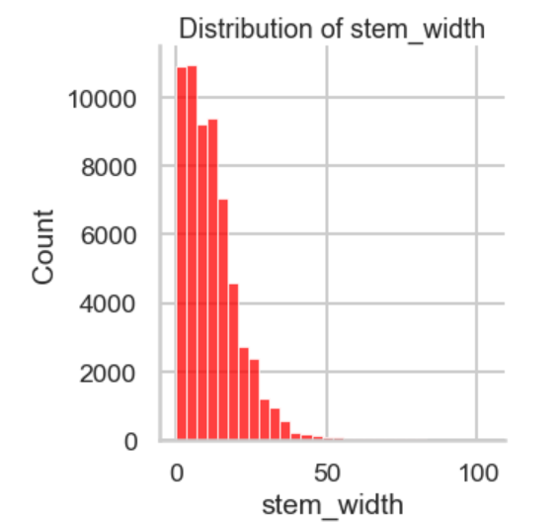
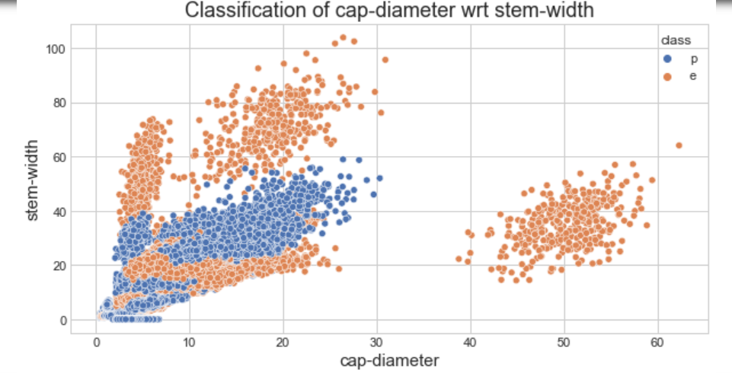
Analysis on stem-width
From the Distribution plot, its clear that most the data points lies between 0 to 60 some towards 100, but it gradually decreases with increase in width i.e more smaller width mushroom are there than bigger.
From the second plot we found that edibility of mushroom increases with increase in width but there should be diameter small.
That means if diameter increases(40-60), the medium range(20-40) width mushrooms are also edible.
So, from the analysis we can recommend organizations to produce seeds that are either have properties of high stem-width low-to medium diameter or high diameter medium width mushrooms.

Slide 8
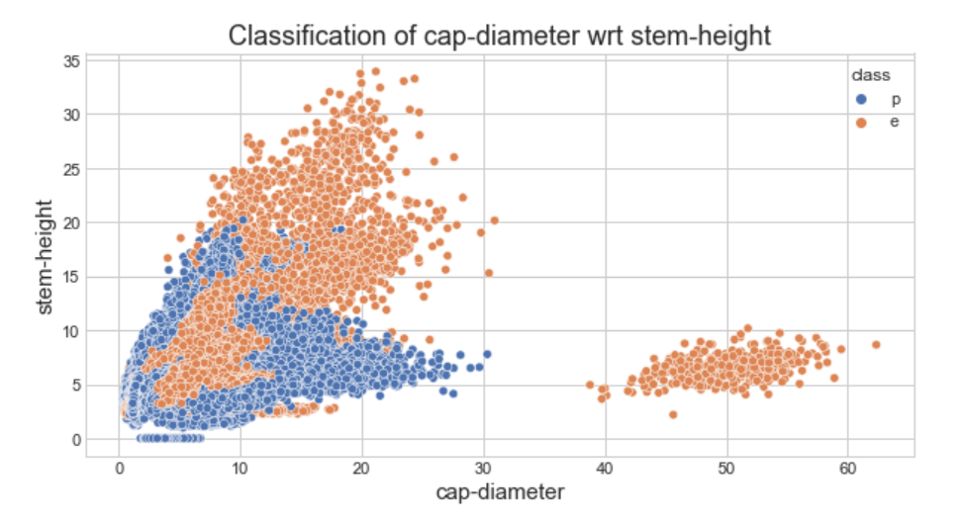
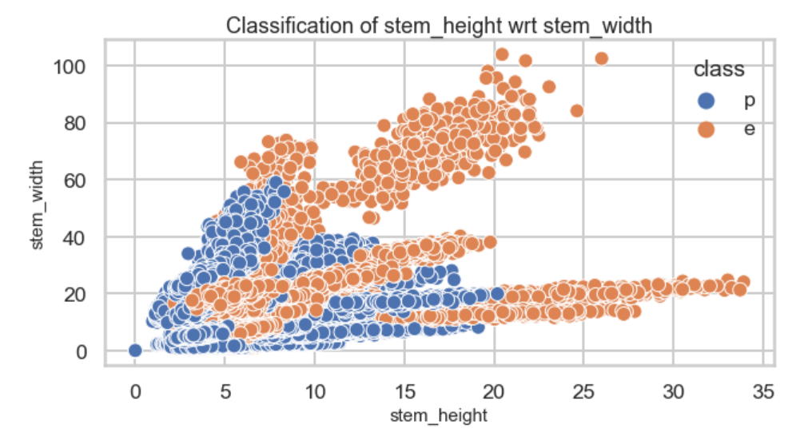
EDA on stem-height
From the scatter plots we found the stem-height data points lies between 0-35 and from distribution with little skew.
Although most of the height mushrooms are edible, but if we compare stem-height with cap-diameter we can see that when diameter is between 0-30 and stem-height is between 0-20 there are lots of poisonous data points.
Similarly if we compare stem-height with stem-width we can see that more poisonous data points when stem-height between 0-20.
From the 2 plots we can conclude that we can find edible mushrooms when stem-height is more than 20 cm when cap-diameter is 0-30 and stem-height 5-10 when cap-diameter is 40-60.

Slide 9
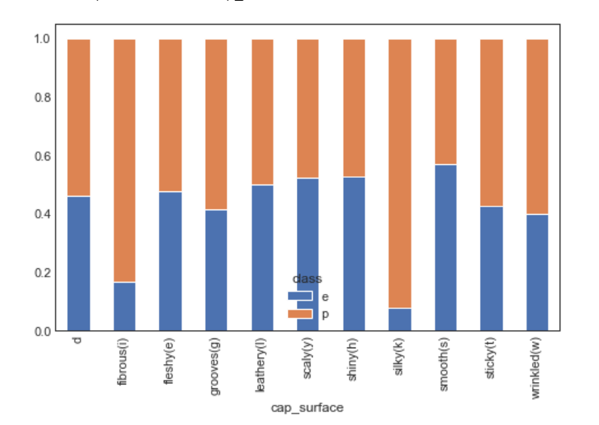
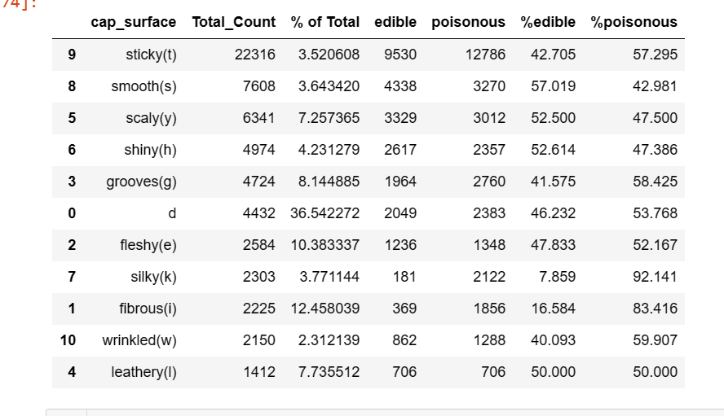
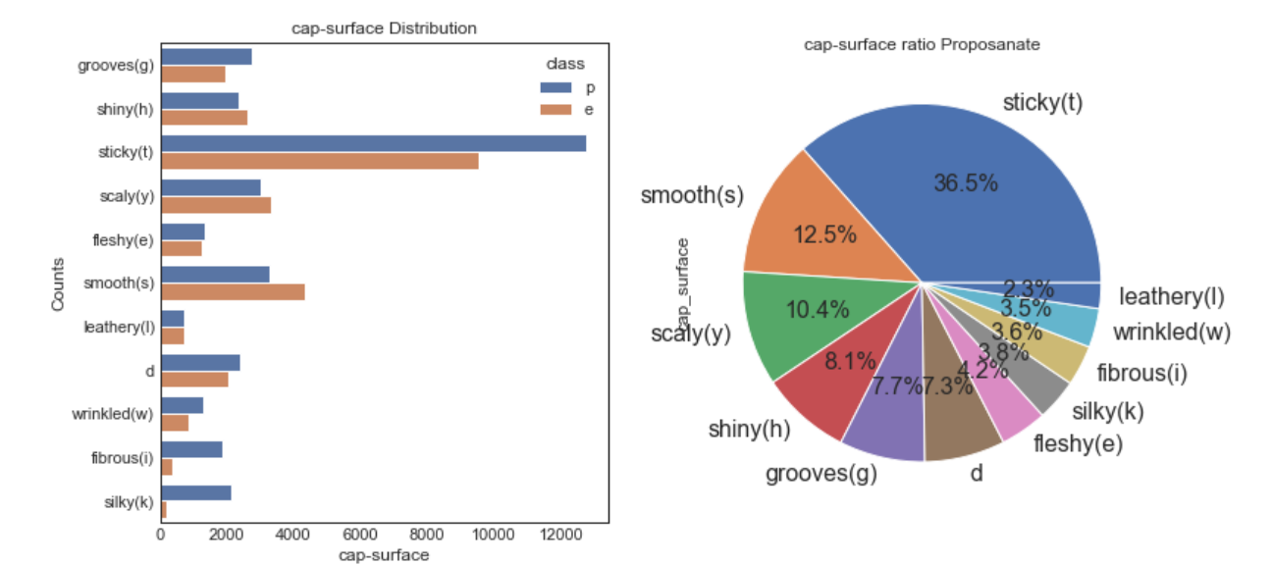
EDA on Cap-surface

Slide 10
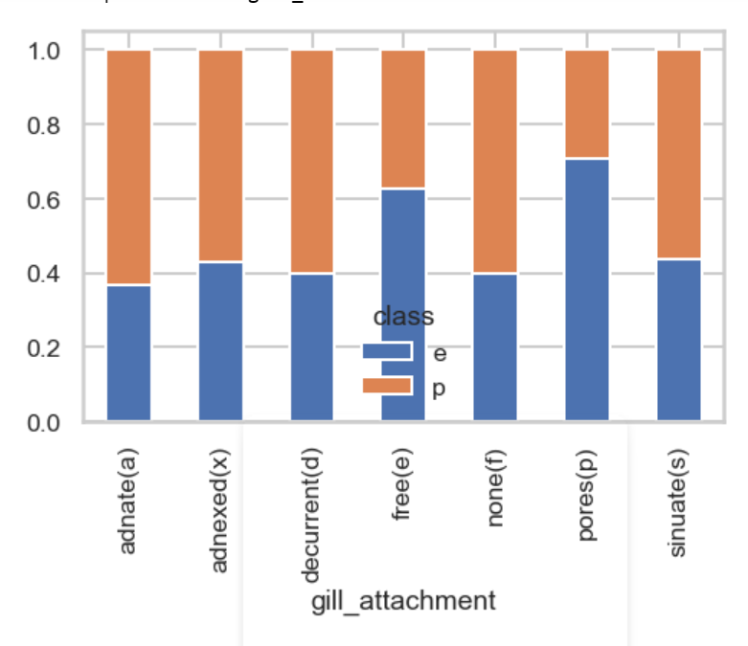
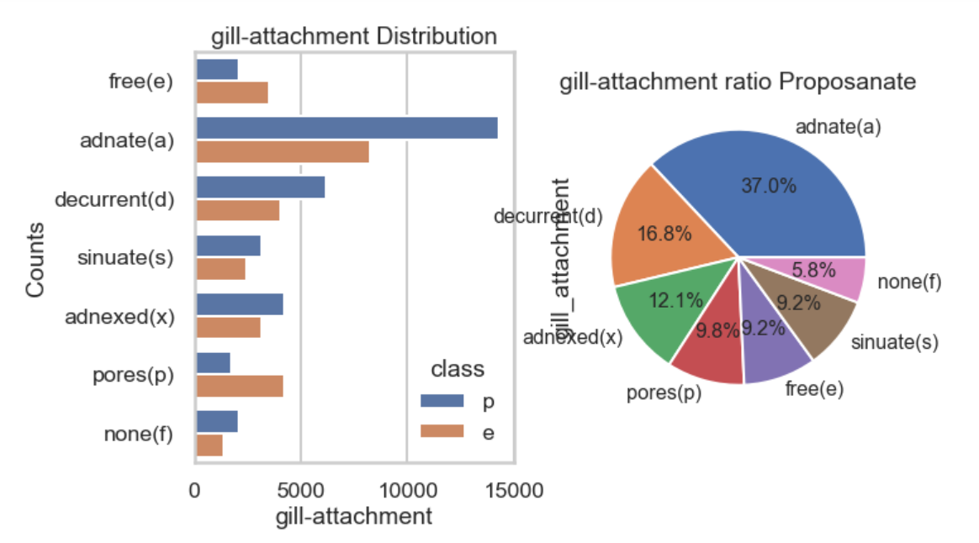
EDA on gill-attachment
adanate(a) and decurrent(d) type are the maximum data in our dataset.
free(e) and pores(p) type gill-attachment are the only where edibility is more than 50%.
While adanate(a) type gill-attachment have highest poisonous nature.

Slide 11
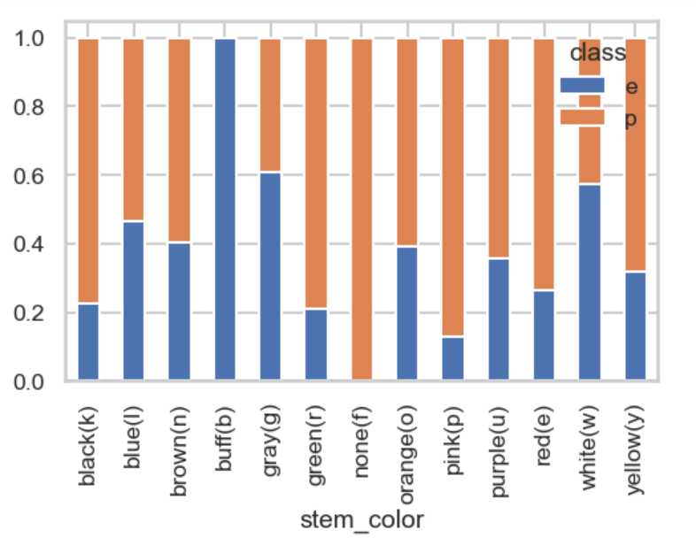
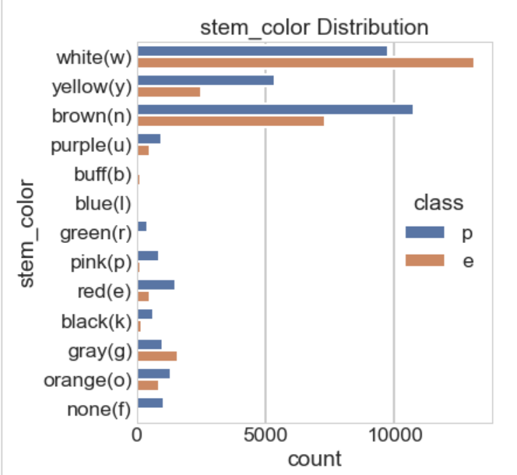
EDA on stem-color
From the plots we can see that white(w) , yellow(y) and brown(n) data points are more in numbers.
But, in terms of edibility we can see that buff(f) stem-color mushroom is almost 100% edible and none(f) stem-color mushroom is almost 100% poisonous. Also grey(g) is 60% and white(w) stem-color is almost 60% edible.

Slide 12
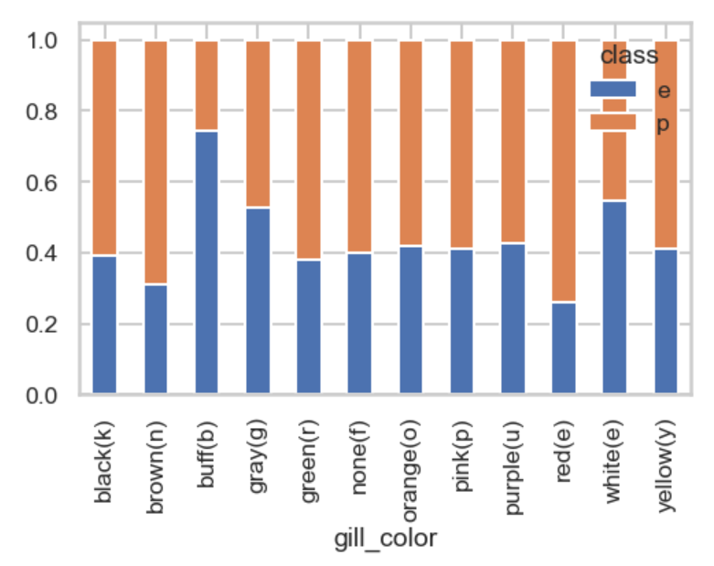
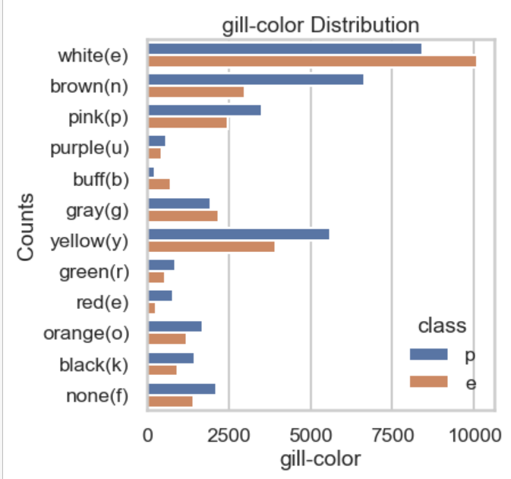
EDA on gill-color
White(w), brown(n) and yellow(y) are the maximum in our dataset.
Only buff(b),grey(g) and white(w) type gill-color mushrooms are more that 50% edible, others are more chance of poisonous, so we need to avoid them for consumption.

Slide 13
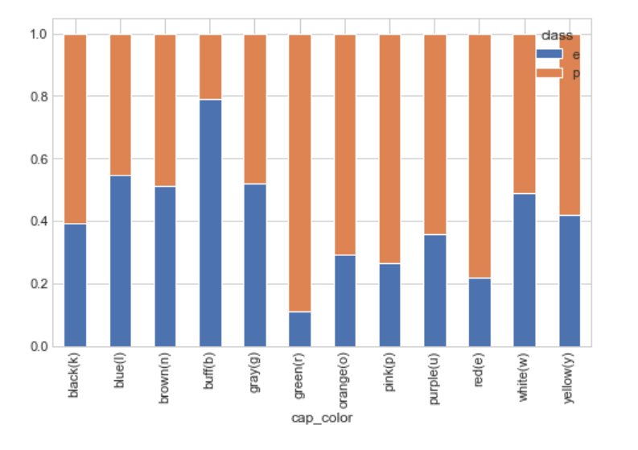
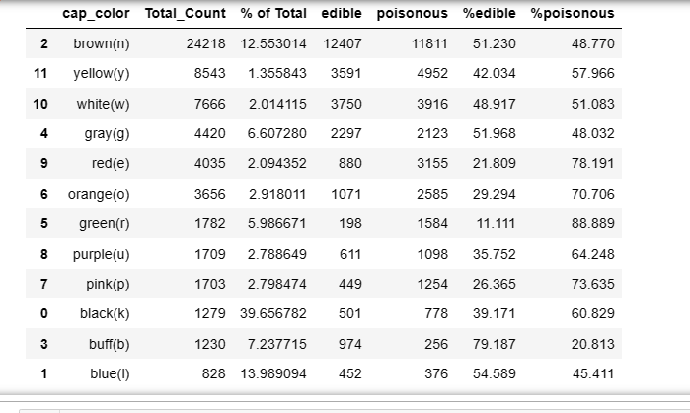
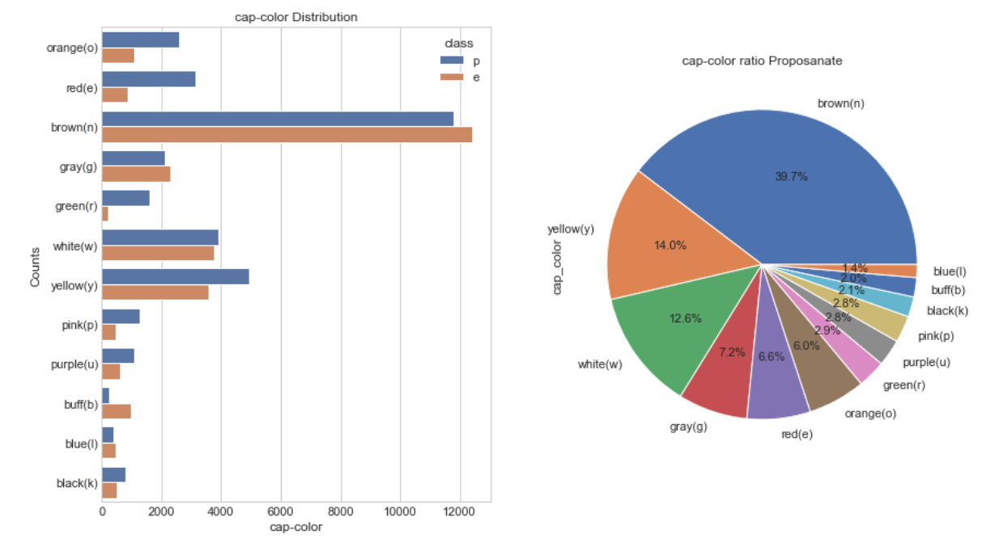
EDA on cap-color

Slide 14
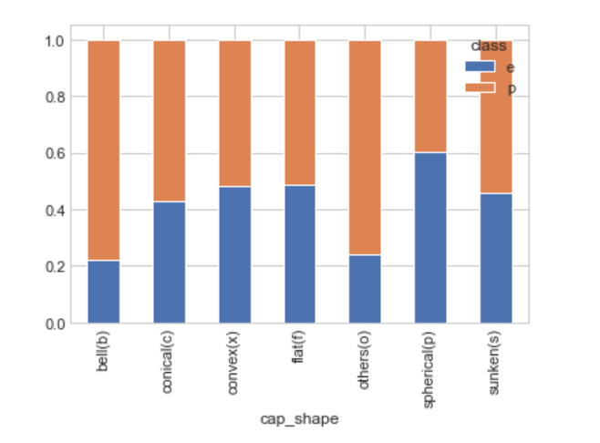
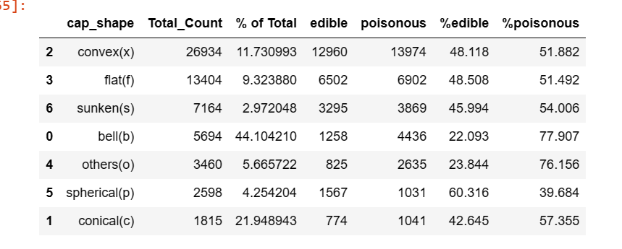
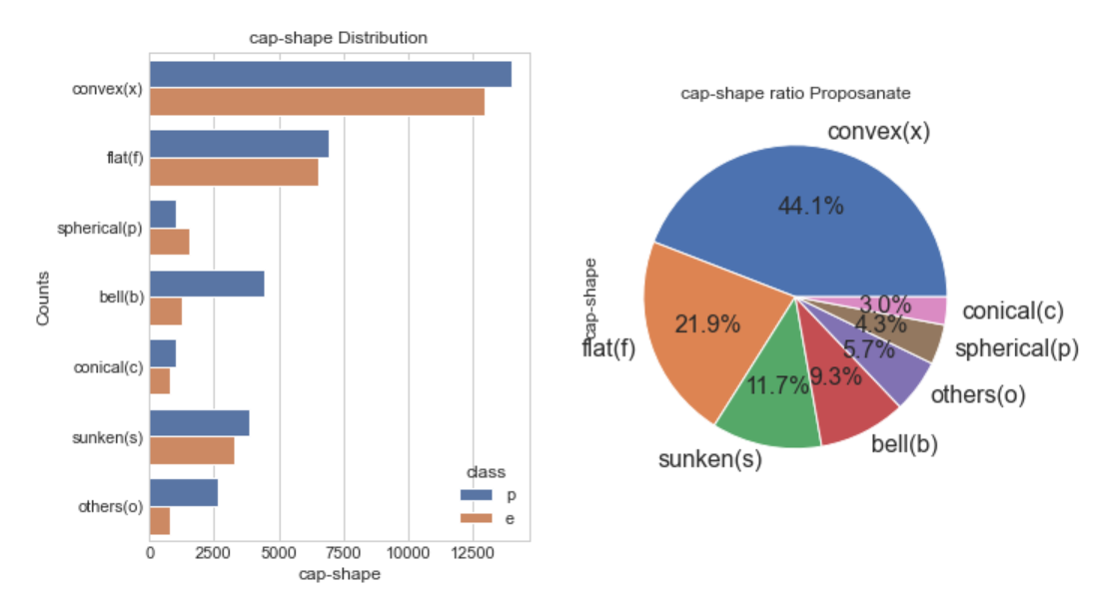
EDA on cap-shape

Slide 15
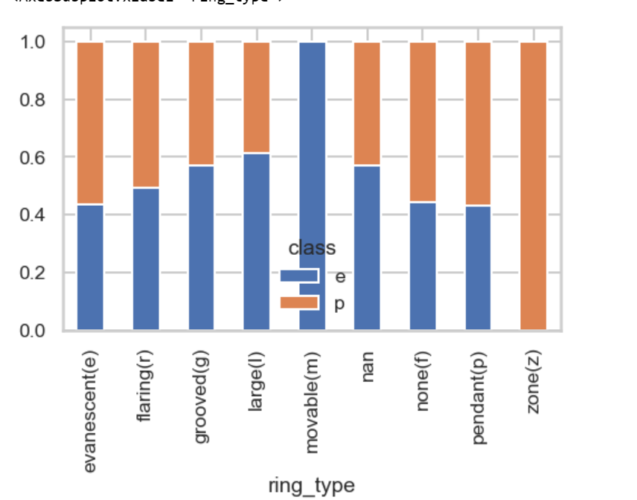
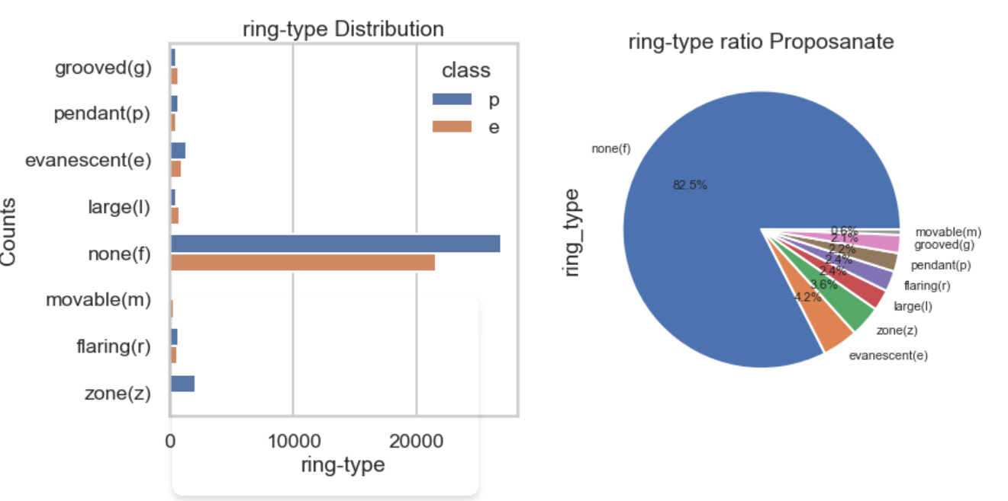
EDA on ring-type
None(f) ring-type have maximum presence in our data.
While when come to edibility movable(m) tring-type is 100% time edible.
Grooveed(g), large(l) also are more than 50% time edible.
While zone(z) ring-type is 100% poisonous.

Slide 16
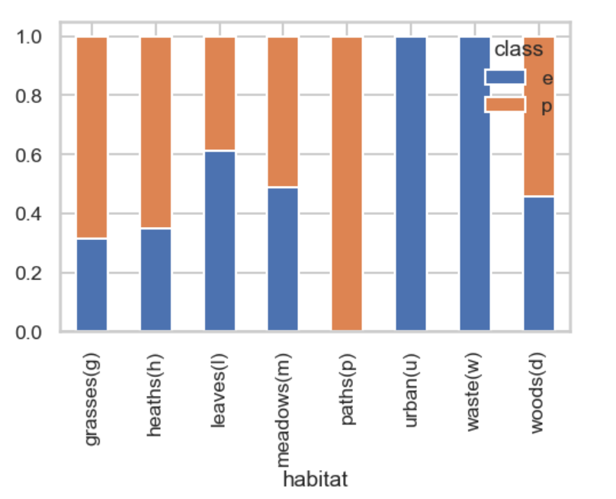
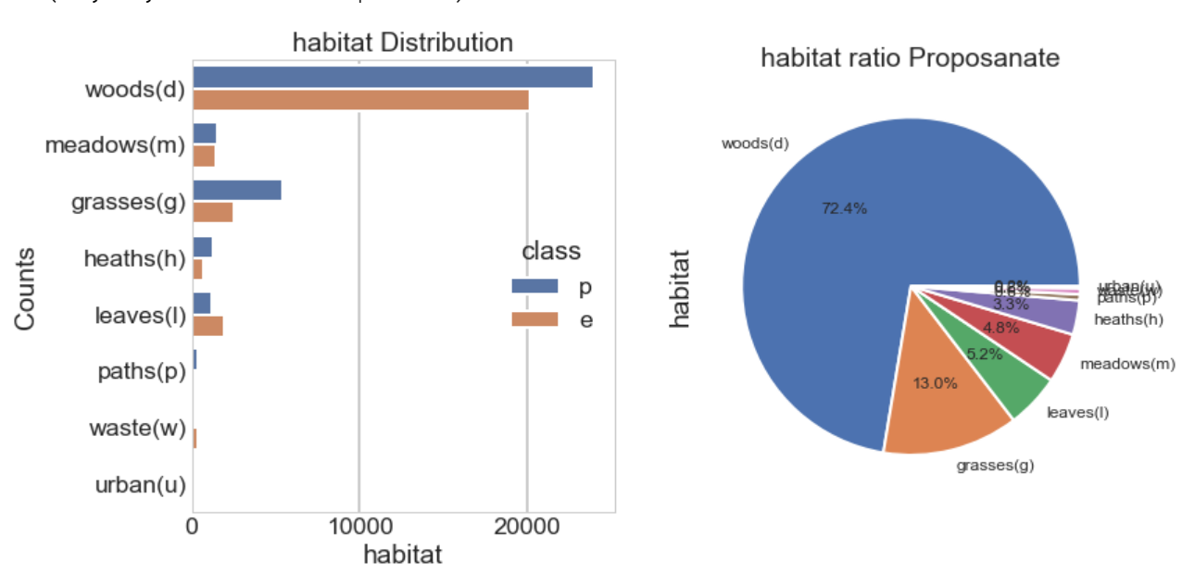
EDA on habitat
Wood(s) habitat mushrooms are maximum in our dataset.
In terms of edibility urban(u) and waste(w) habitat mushrooms are 100% edible.
While leaves(l) habitat mushrooms are more than 50% edible.
Paths(p) habitat mushrooms are 100% poisonous.

Slide 17
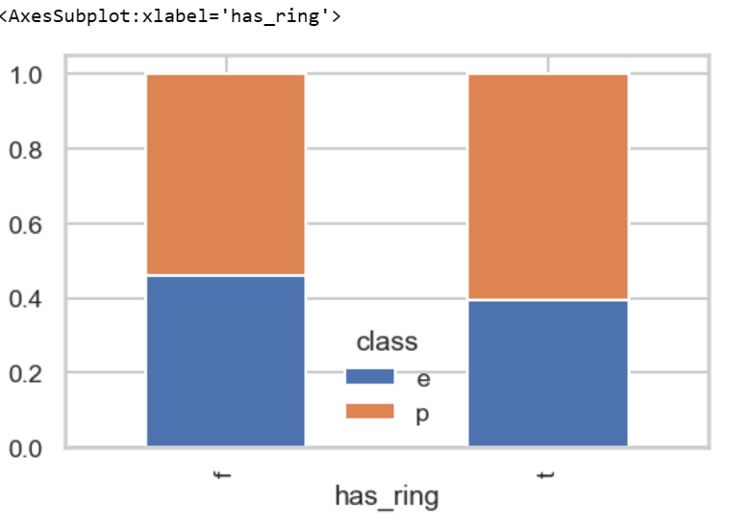
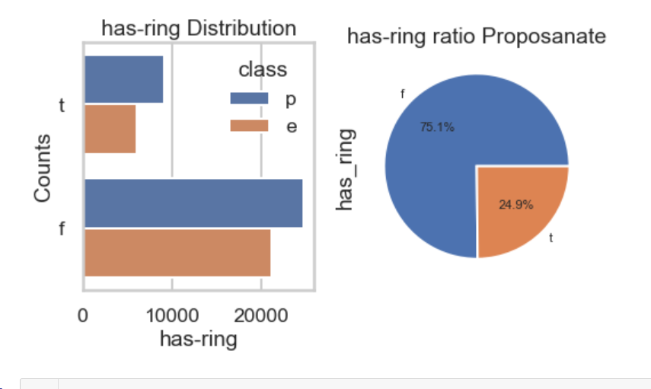
EDA on has-ring
75% data in our dataset are not having ring that is f, while 24.9% data has ring.
Mushrooms having ring are less than 40% times edible that means more than 60% time poisonous.
Mushrooms not having ring are slightly more than 40% edible.

Slide 18
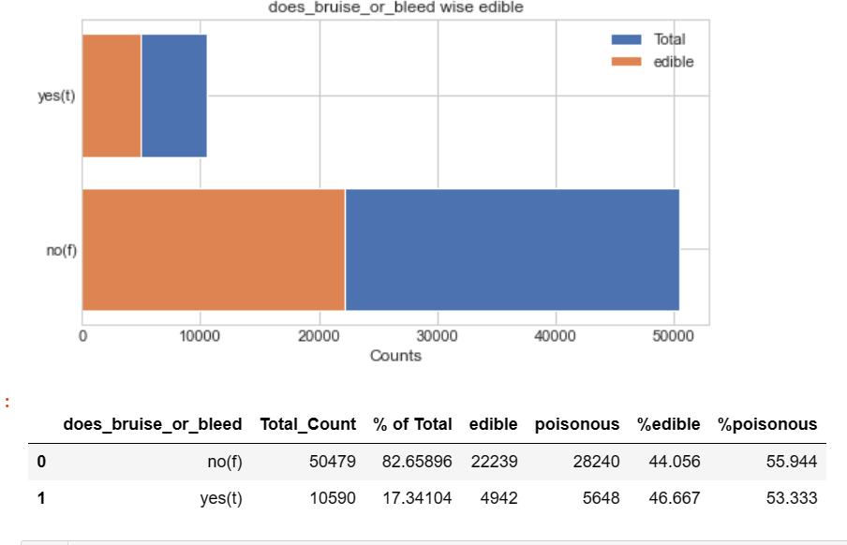
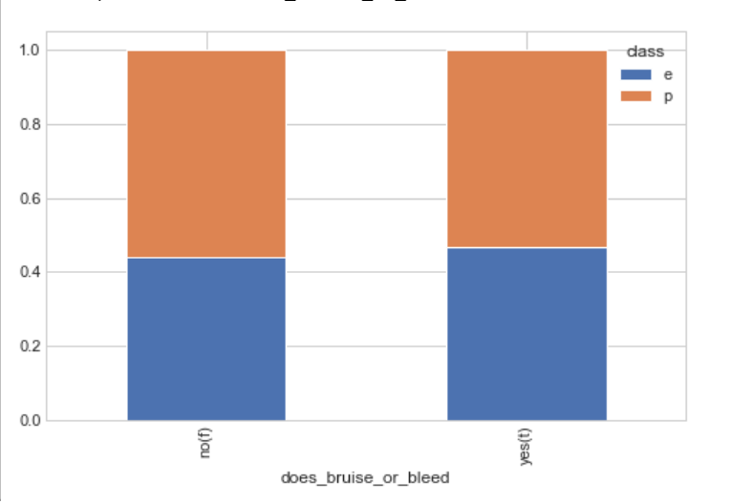
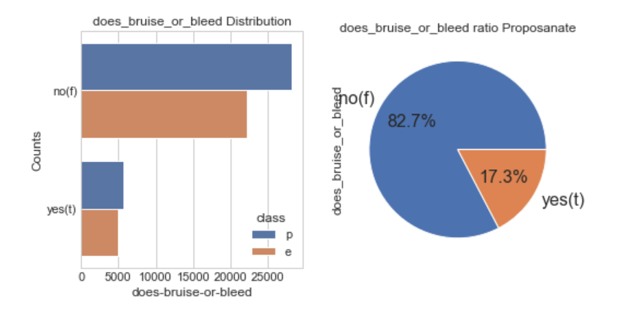
EDA on does-bruise-or-bleed

Slide 19
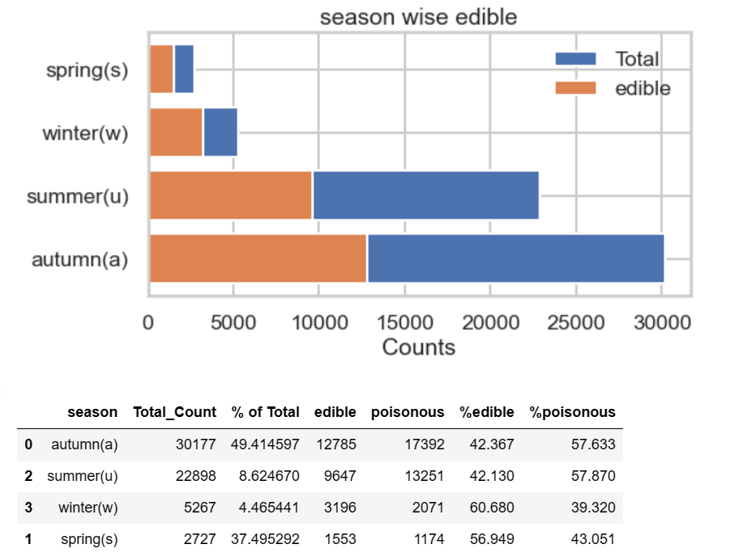
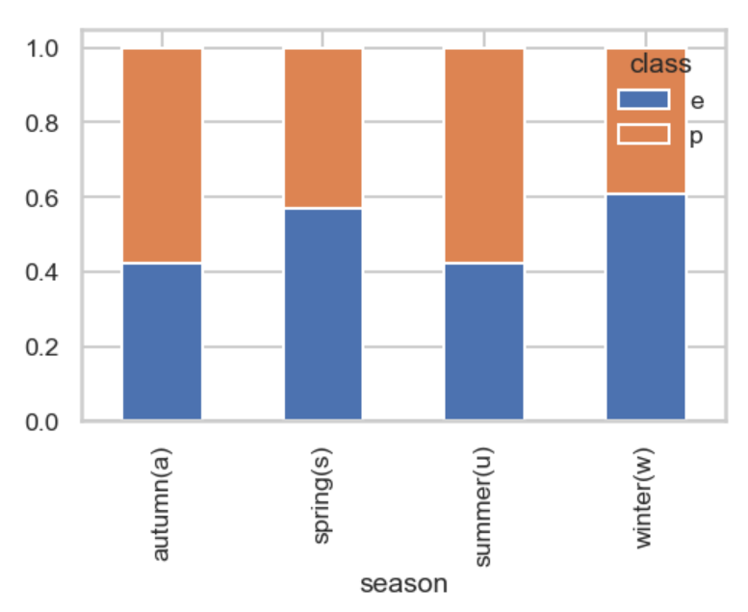
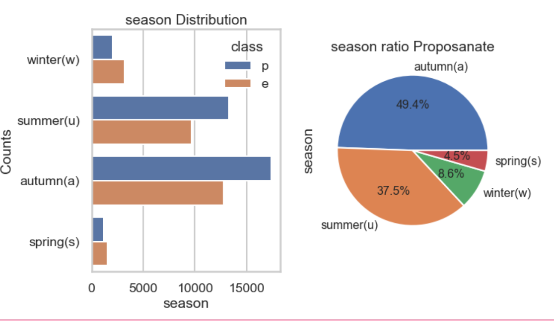
EDA on season

Slide 20
Recommendation
Mushroom having high stem-width(40-60) with lo-medium cap=diameter(20-40) or medium stem-width with high cap-diameter(41-60) are more likely be edible and mushroom having both low-medium stem-width with cap-diameter most likely be poisonous. So we should avoid mushrooms having stem-width(0-50) with cap-diameter(0-30) as they are most likely be poisonous.
Similarly mushrooms having medium-high stem-height(12-35) with cap-diameter(10-30) and stem-height(5-10) with cap-diameter(40-60) are more likely be edible and stem-height(0-15) with cap-diameter(0-20) are more likely be poisonous, so need to avoid those.
similarly., mushrooms having stem-width(40-100) with stem-height(15-35) are more likely be edible and stem-width(0-50) with stem-height(0-20) are more likely be poisonous. So, we should focus on mushrooms having high stem-width with high stem-height for edibility and low-medium stem-width with low stem-height for poisonous mushrooms.
smooth(s), scaly(y) and shiny(h) type cap-surface mushrooms are more than 50% time edible while leathery(l) type cap-surface are 50% time edible and fibrous(i) ,silky(k) are highly poisonous while grooves(g),d, fleshy(e), winkled(w) type cap-surface mushrooms are more than 50% chance of being poisonous. So, we need to avoid these.
When it come gill-attachment type then only free() and pores() type gill-attachment are more than 50% edible, so we need avoid other type gill-attachment mushrooms.
Stem having colour buff(b) is 100% edible, other than that grey(g) and white(w) stem-color type mushrooms are more than 50% time edible. F stem-color type mushroom are 100% poisonous, se we need to avoid it.
Only buff(b),grey(g) and white(w) type gill-color mushrooms are more that 50% edible, others are more chance of poisonous, so we need to avoid them for consumption. red(e) type gill-color mushroom are most poisonous.

